Slide 1

MENTAL HEALTH WELLNESS USING AI AGENT
Sagar Mane:- 23106032
Rajanya Kshatriya:- 23106096
Ramnarayan Maurya:-23106119
Sarvesh Bhartu:- 23106019
Project Guide
Dr. Bharti Khemani
Academic year 2025-26
Notes:
1

Slide 2
Outline
Introduction
Literature Survey of Existing Systems
Limitations in Existing Systems
Problem Statement
System Design
Technologies and Methodologies
Implementation Screenshots
Conclusion
References

Slide 3
Introduction
Mental health challenges such as stress, anxiety, and depression are rapidly increasing among students, yet support remains either inaccessible, highly clinical, or not engaging enough. Existing solutions are often designed with a westernized approach, overlooking the cultural and linguistic diversity of our context. To address this gap, we aim to create a personalized, continuous, and supportive platform that is not only stigma-free but also multilingual and culturally sensitive, making mental wellness resources more accessible and relatable for everyone.
So in short, Mental health challenges among students are rising, but support is still either inaccessible or ineffective and that’s the gap we aim to bridge.
Notes:
3

Slide 4
Literature Survey:
Title | Conference / Journal Details | Key Points | Improvements Proposed
Artificial Intelligence–Enabled Chatbots in Mental Health: A Systematic Review | Systematic Review, CMC, 2023 | AI chatbots deliver CBT; provide 24/7 access and counter professional shortages. | Close gap between AI tech and clinical use; establish clear ethical guidelines.
A New Research Model for Artificial Intelligence–Based Well-Being Chatbot Engagement: Survey Study | Survey Study, JMIR Human Factors, 2024 | Engagement driven by Affect, Social Factors, and Personalization. Offers companionship/guidance. | Design systems that adapt to user personality/needs; improve emotional intelligence.
Exploring the Dangers of AI in Mental Health Care | Research Report, Stanford HAI, 2025 | LLM chatbots showed harmful stigma and, in some cases, enabled dangerous/suicidal behavior. | Implement rigorous safety guardrails; eliminate bias and ensure proper crisis escalation
Effectiveness of AI-Driven Conversational Agents in Improving Mental Health Among Young People | Systematic Review & Meta-Analysis, JMIR, 2025 | Moderate-to-large effect size for AI-CBT on depression/anxiety (SMD ≈0.44). Effective for younger users. | Conduct longer-term, multicultural trials; enhance efficacy for broader mental health outcomes.

Slide 5
Limitations in Existing Systems
Lack of Genuine Empathy
Crisis Management Failure
Algorithmic Bias
Data Privacy & Trust
Limited Long-Term Efficacy
Risk of Over-Reliance

Slide 6
Problem statement
To design an AI-powered solution that not only enables safe self-expression but also offers personalized, empathetic, and culturally relevant guidance, while ensuring complete confidentiality and stigma-free access to reliable mental wellness resources and timely support for young people in India who struggle with academic, social, and emotional pressures.

Slide 7
Overview of System Design
Features/Components :
Anonymous User authentication
Conversational AI Assistant
Sentiment & Risk Detection
Journaling
Community Forum
Confidential Counselor Booking
Psychoeducational Resource Hub
Gamification & Engagement (streaks, XP, plant growth, badges)
Counselor/Admin Dashboard
Notes:
7

Slide 8
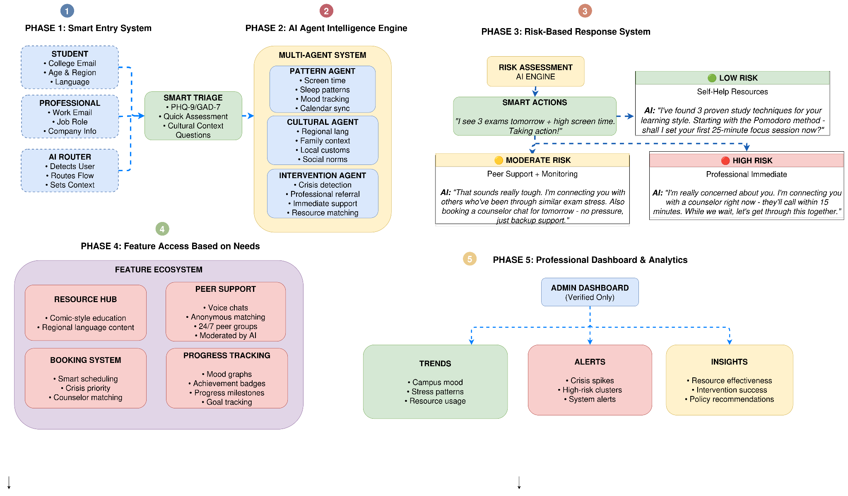
Fig. 1 : Block diagram of proposed system

Slide 9
Technology Stack
Frontend: React Native (Student App), React.js (Dashboard), TailwindCSS & Material UI (UI) Backend: Node.js + Express Databases: Firebase (journals, forum, gamification), PostgreSQL (counselor profiles, analytics) AI/ML: DistilBERT (chat), PHQ-9/GAD-7/GHQ-12 (risk), Vertex AI Vector Search (RAG), content filters, personalization engine Voice & Multilingual: Google STT, Google TTS, IndicTrans2 Hosting & DevOps: GCP / AWS (Cloud Run + Firebase)
Notes:
9

Slide 10
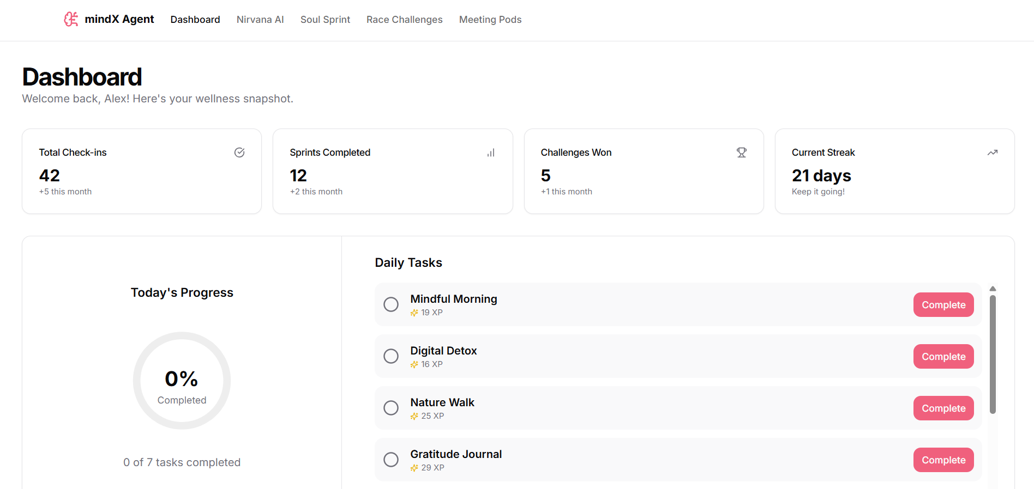
Implementation Screenshots
Fig. 2 : Dashboard

Slide 11
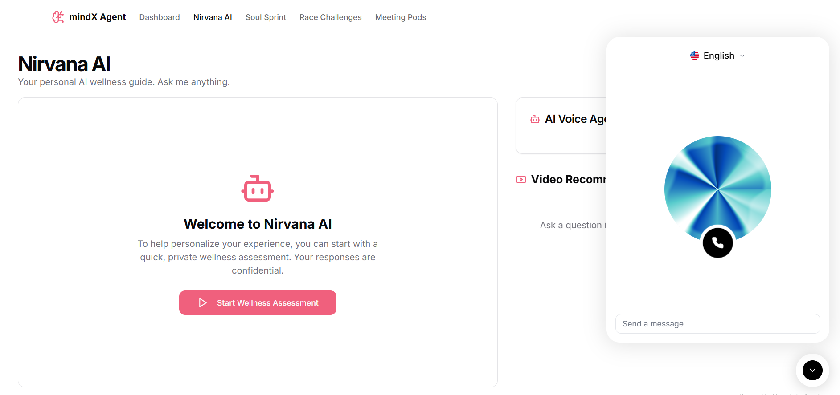
Fig. 3 : Assesments & AI Assistance

Slide 12
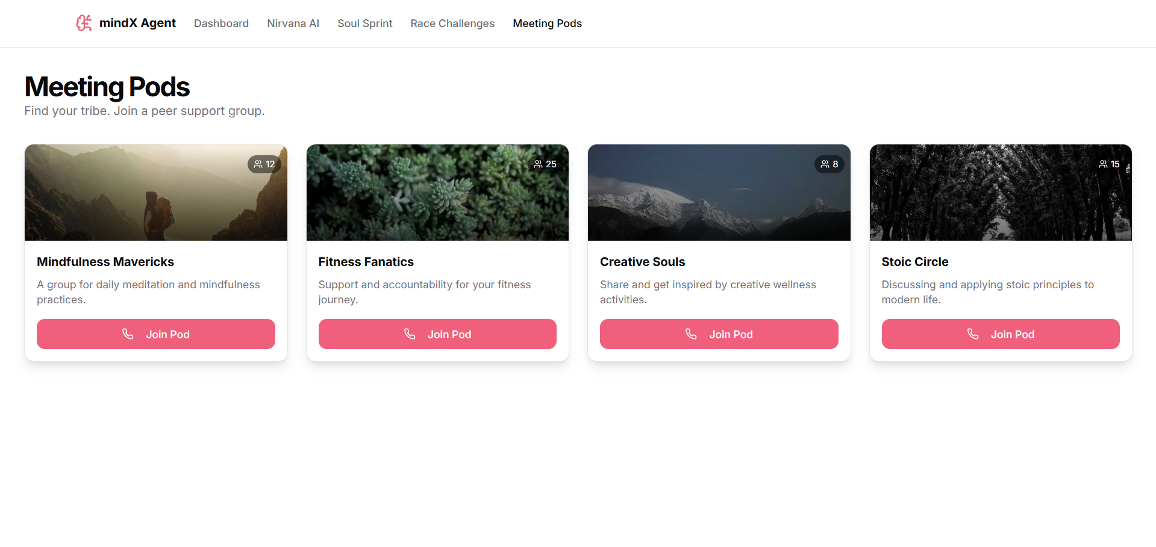
Fig. 4 : Meeting Pods

Slide 13
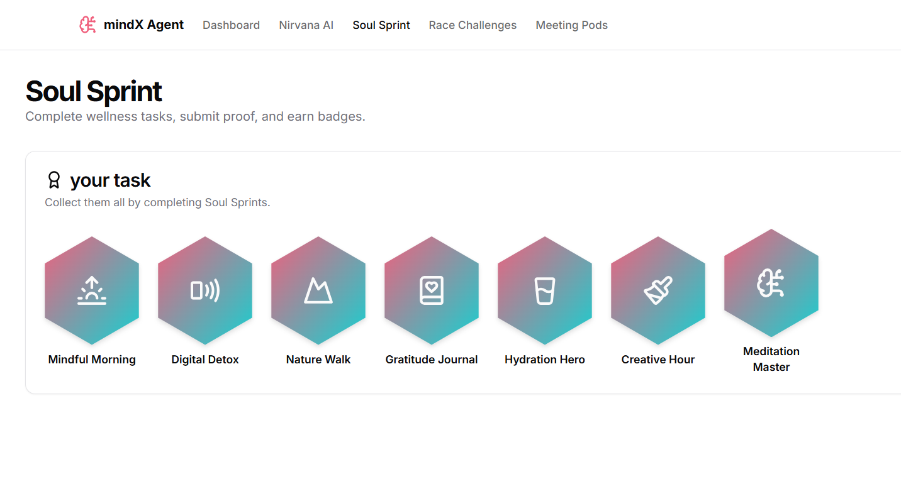
Fig. 5 : Daily Challenges

Slide 14
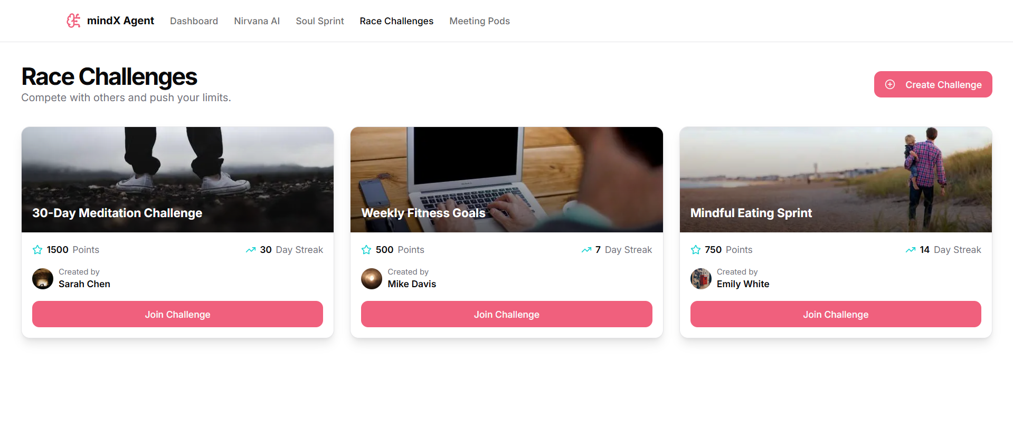
Fig. 6 : Competitive Challenges

Slide 15
Conclusion
Our platform addresses the rising mental health challenges among students by providing accessible, personalized, and culturally sensitive support. Through features like the conversational AI assistant, mood tracking, resources hub, gamified engagement, confidential bookings, and an admin dashboard, we aim to empower students, reduce stigma, and make mental wellness a part of everyday life bridging the gap in mental health support with innovation, inclusivity, and continuous engagement.

Slide 16
References
[1] Gamification and AI: Enhancing User Engagement through Intelligent Systems -Carlos J. Costa, Joao Tiago Aparicio, Manuela Aparicio, Sofia Aparicio (2024)
https://drive.google.com/file/d/1EuF_fT43h20ok2wMkFB2FGsgQVVcTEh_/view?usp=drive_link
[2] Adaptive Learning Using Artificial Intelligence in e-Learning: A Literature Review - Ilie Gligorea , Marius Cioca, Romana Oancea, Andra-Teodora Gorski, Hortensia Gorski and Paul Tudorache (2024)
https://drive.google.com/file/d/1UMRUOXfz8PkZzffbKYi9Yr-C4Cu1t1VW/view?usp=drive_link
[3] Gamified AI-Driven Assessments - Namya Joshi , Monica Joshi (2024)
https://drive.google.com/file/d/1yBbOR6ffz0DT5AWzpjeLdwy7A2SYxhOA/view?usp=drive_link
[4] Leveraging AI in E-Learning: Personalized Learning and Adaptive Assessment through Cognitive Neuropsychology—A Systematic Analysis - Constantinos Halkiopoulos and Evgenia Gkintoni (2024)
https://drive.google.com/file/d/1QdD1uXSLoSyDKS5V5dS9ToipkocNyF_r/view?usp=drive_link
[5] Analyzing the Impact of Gamification Techniques on Enhancing Learner Engagement, Motivation, and Knowledge Retention: A Structural Equation Modeling Approach - Lassaad Smirani and Hanaa Yamani (2024)
https://drive.google.com/file/d/18xmyvHehW6b_d8mVt40h4dmvlYbKZT14/view?usp=drive_link

Slide 17

Thank You...!!
Notes:
17

